Slide 1

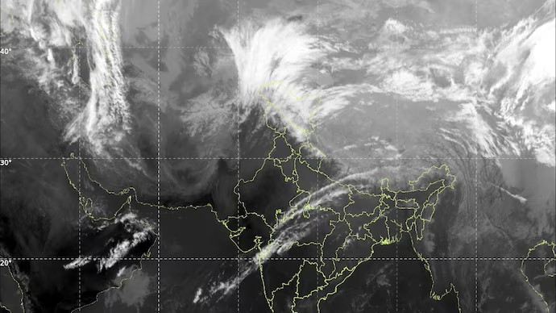
Weather Pattern Analysis Using Power BI
Submitted By: Rashi Bansal
Roll Number: 2420422
Course: BTech CSE (Data Science)

Slide 2
Project Overview
Project Description
The Weather Pattern Analysis using Power BI project aims to analyse historical weather data from multiple Indian cities between 2024 and 2026. The project focuses on identifying trends in temperature, rainfall, seasonal variations, and extreme weather conditions. Interactive dashboards were developed in Power BI to transform raw weather data into meaningful insights for better understanding and decision-making.
Objectives
• Analyse temperature variations across cities and seasons.
• Study rainfall distribution and seasonal rainfall patterns.
• Identify cities experiencing extreme weather conditions.
• Compare weather trends from 2024 to 2026.
• Summarize key weather insights using interactive dashboards.
Tools & Technologies Used
Microsoft Power BI
Microsoft Excel (Dataset)
Power Query (Data Cleaning)
DAX Measures
Data Visualization

Slide 3
Dataset Overview
Dataset Description
The dataset contains historical weather observations collected from 10 major Indian cities between 2024 and 2026. It includes information on temperature, rainfall, seasons, dates, and weather conditions. The data was cleaned using Power Query before creating interactive dashboards in Power BI.
Dataset Details
Dataset Name: Weather Dataset
Time Period: 2024–2026
Number of Records: ~7,000
Number of Cities: 10
Data Source: Excel Dataset
Visualization Tool: Microsoft Power BI
Features Used
City
Date
Year
Month
Season
Mean Temperature
Maximum Temperature
Minimum Temperature
Temperature Range
Rainfall (mm) Rainfall Category
Rainy Days
Non-Rainy Days
Daily Duration

Slide 4
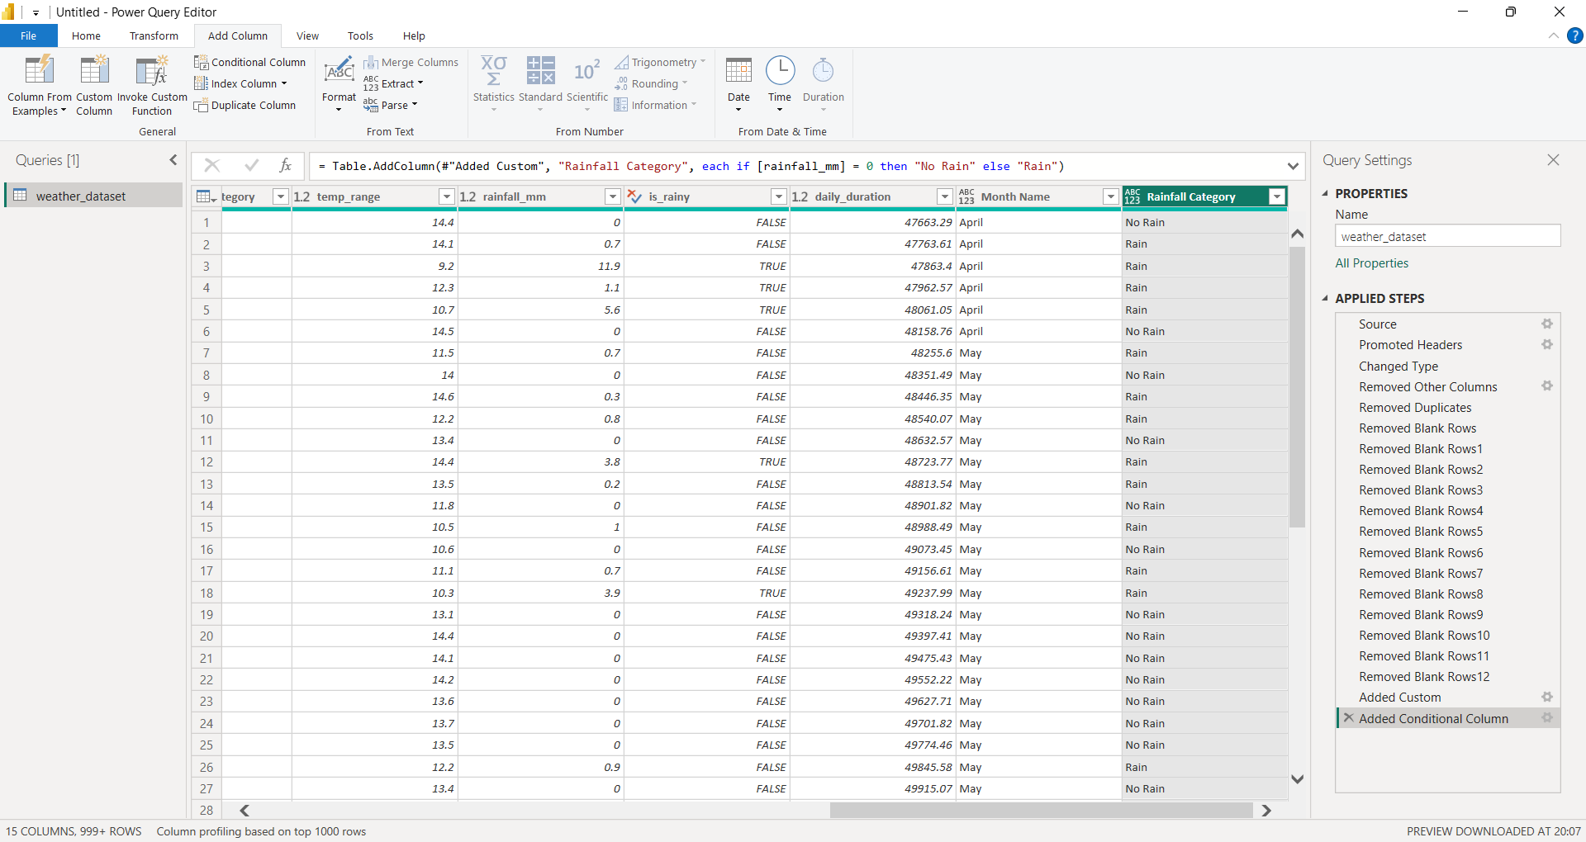
Data Cleaning & Preparation
Data Cleaning Steps
Imported the Excel weather dataset into Power BI.
Verified and corrected data types.
Removed duplicate records.
Checked and handled missing values.
Created Month Name column.
Sorted Month Name using Month Number.
Standardized city and season names.
Created calculated columns for analysis.

Slide 5
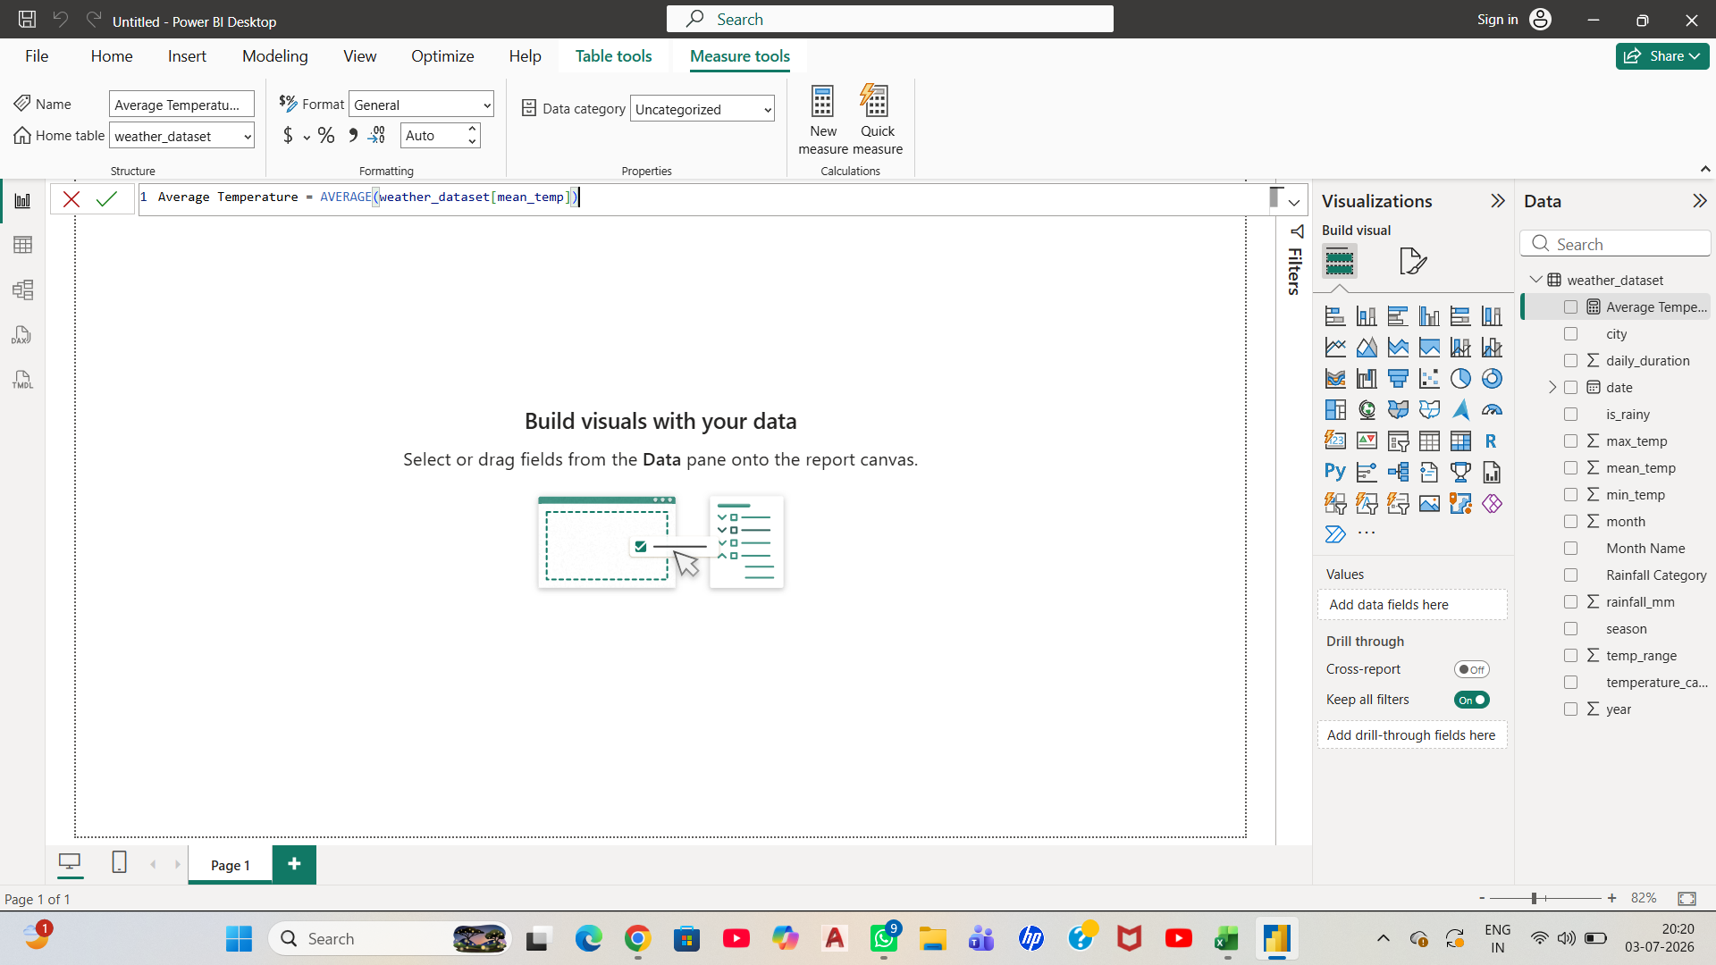
DAX Measures & Calculations
Measures Created
Average Temperature
Maximum Temperature
Minimum Temperature
Average Rainfall
Total Rainfall
Rainy Days
Non-Rainy Days
Total Records
Temperature Range
Purpose of DAX Measures
Created reusable calculations.
Simplified dashboard development.
Improved report accuracy.
Enabled dynamic KPI cards and charts.

Slide 6
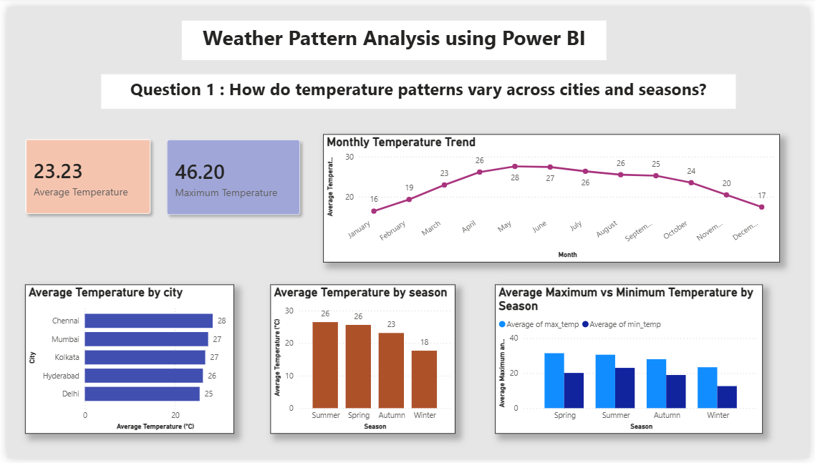
Dashboard 1 – Temperature Analysis
Key Insights
Summer recorded the highest average temperature.
Winter showed the lowest average temperature.
Chennai and Mumbai experienced higher average temperatures.
Monthly temperature increased from January and peaked around May–June before declining.

Slide 7
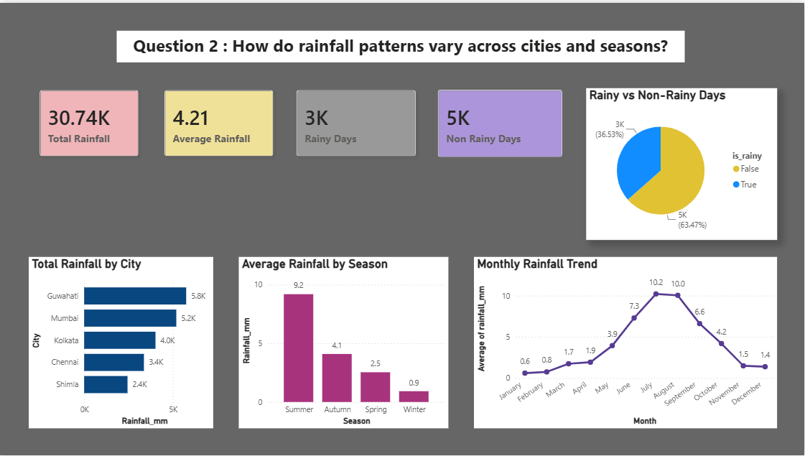
Dashboard 2 – Rainfall Analysis
Key Insights
Summer received the highest rainfall.
Guwahati recorded the maximum rainfall among the selected cities.
Rainfall peaked during July and August.
Around one-third of the recorded days were rainy, while the remaining days were non-rainy.

Slide 8
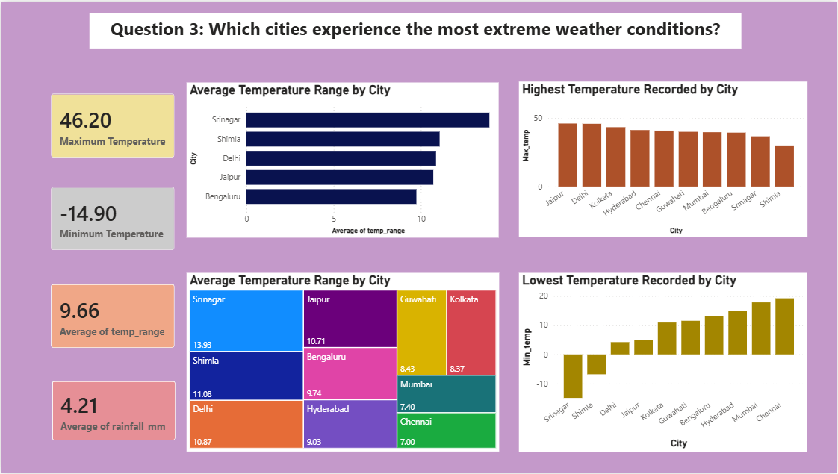
Dashboard 3 – Extreme Weather Analysis
Key Insights
Jaipur recorded the highest maximum temperature.
Srinagar experienced the lowest minimum temperature.
Srinagar also had the largest average temperature range.
Temperature variation differed significantly between cities.

Slide 9
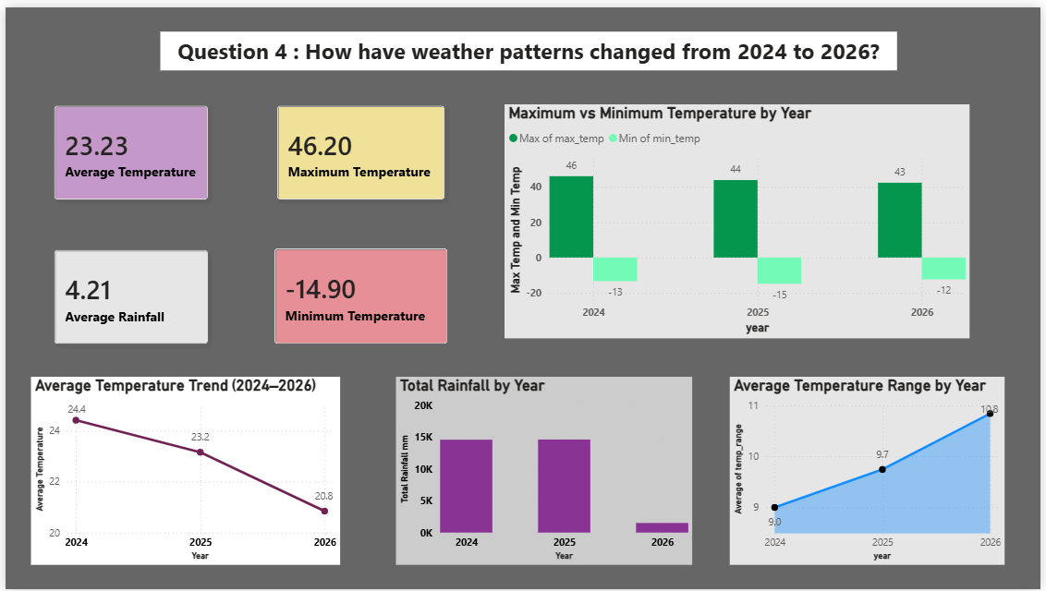
Dashboard 4 – Year-wise Trend Analysis
Key Insights
Average temperature showed slight variation across the three years.
Maximum and minimum temperatures remained relatively stable.
Rainfall varied between years.
Temperature range exhibited gradual changes over time.

Slide 10
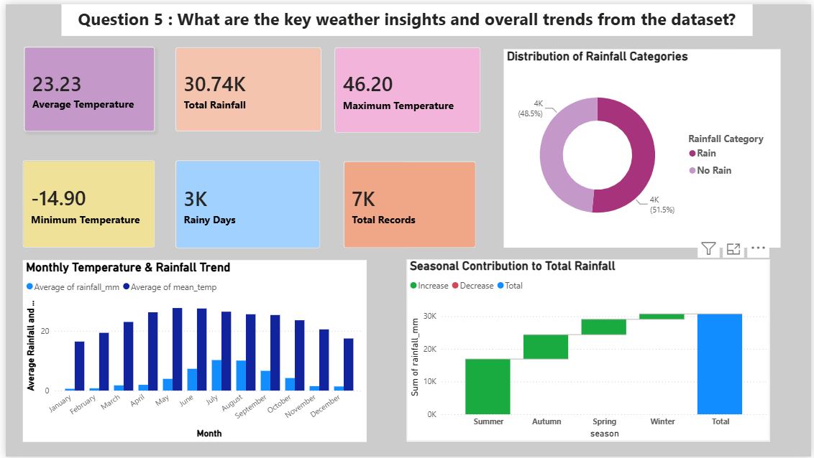
Dashboard 5 – Overall Weather Insights
Key Insights
The dataset contained approximately 7,300 weather observations.
The overall average temperature was about 23°C.
Total rainfall exceeded 30,000 mm across all observations.
Nearly 3,000 rainy days were recorded.
Monthly temperature and rainfall followed distinct seasonal patterns.

Slide 11
Overall Findings
Challenges
Learning Power BI from scratch.
Creating DAX measures.
Sorting months correctly.
Designing meaningful dashboards.
Selecting the most appropriate visualizations.
Ensuring dashboard consistency and readability.
Major Findings
Weather patterns vary considerably across cities.
Summer is generally the hottest season.
Rainfall is concentrated during the monsoon months.
Some cities experience much larger temperature fluctuations than others.
Weather trends remained fairly consistent between 2024 and 2026.

Slide 12
Conclusion
This project successfully analysed weather patterns using Power BI. Interactive dashboards provided valuable insights into temperature, rainfall, seasonal variation, extreme weather conditions, and yearly trends. The project demonstrates how business intelligence tools can transform raw weather data into meaningful visual insights that support informed decision-making.

